Slide 1
Chapter 2
Computer Abstractions and Technology
Lesson 5: MIPS (cont…)

Slide 2
Logical Operations
Instructions for bitwise manipulation
§2.6 Logical Operations
Operation | C | Java | MIPS
Shift left | << | << | sll
Shift right | >> | >>> | srl
Bitwise AND | & | & | and, andi
Bitwise OR | | | | | or, ori
Bitwise NOT | ~ | ~ | nor
Useful for extracting and inserting groups of bits in a word

Slide 3
Shift Operations
op
rs
rt
rd
shamt
funct
6 bits
5 bits
5 bits
5 bits
5 bits
6 bits
shamt: how many positions to shift
Shift left logical
Shift left and fill with 0 bits
sll by i bits multiplies by 2^{i}
Shift right logical
Shift right and fill with 0 bits
srl by i bits divides by 2^{i} (unsigned only)

Slide 4
AND Operations
Useful to mask bits in a word
Select some bits, clear others to 0
and $t0, $t1, $t2
$t2
0000 0000 0000 0000 0000 1101 1100 0000
$t1
0000 0000 0000 0000 0011 1100 0000 0000
$t0
0000 0000 0000 0000 0000 1100 0000 0000

Slide 5
OR Operations
Useful to include bits in a word
Set some bits to 1, leave others unchanged
or $t0, $t1, $t2
$t2
0000 0000 0000 0000 0000 1101 1100 0000
$t1
0000 0000 0000 0000 0011 1100 0000 0000
$t0
0000 0000 0000 0000 0011 1101 1100 0000

Slide 6
NOT Operations
Useful to invert bits in a word
Change 0 to 1, and 1 to 0
MIPS has NOR 3-operand instruction
a NOR b == NOT ( a OR b )
nor $t0, $t1, $zero
Register 0: always read as zero
$t1
0000 0000 0000 0000 0011 1100 0000 0000
$zero
0000 0000 0000 0000 0000 0000 0000 0000
$t0
1111 1111 1111 1111 1100 0011 1111 1111

Slide 7
Conditional Operations
Branch to a labeled instruction if a condition is true
Otherwise, continue sequentially
beq rs, rt, L1
if (rs == rt) branch to instruction labeled L1;
bne rs, rt, L1
if (rs != rt) branch to instruction labeled L1;
j L1
unconditional jump to instruction labeled L1
§2.7 Instructions for Making Decisions

Slide 8
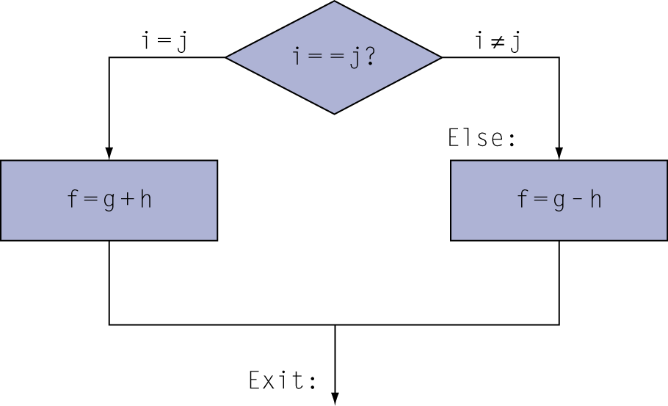
Compiling If Statements
C code:
if (i==j) f = g+h; else f = g-h;
f, g, … in $s0, $s1, …
Compiled MIPS code:
bne $s3, $s4, Else add $s0, $s1, $s2 j Exit Else: sub $s0, $s1, $s2 Exit: …
Assembler calculates addresses

Slide 9
Compiling Loop Statements
C code:
while (save[i] == k) i += 1;
i in $s3, k in $s5, address of save in $s6
Compiled MIPS code:
Loop: sll $t1, $s3, 2 //multiply by 4 (i.e. 2²) add $t1, $t1, $s6 //add i*4 to base address lw $t0, 0($t1) bne $t0, $s5, Exit addi $s3, $s3, 1 j Loop Exit: …

Slide 10
Basic Blocks
A basic block is a sequence of instructions with
No embedded branches (except at end)
No branch targets (except at beginning)
A compiler identifies basic blocks for optimization
An advanced processor can accelerate execution of basic blocks

Slide 11
More Conditional Operations
Set result to 1 if a condition is true
Otherwise, set to 0
slt rd, rs, rt
if (rs < rt) rd = 1; else rd = 0;
slti rt, rs, constant
if (rs < constant) rt = 1; else rt = 0;
Use in combination with beq, bne
slt $t0, $s1, $s2 # if ($s1 < $s2) bne $t0, $zero, L # branch to L

Slide 12
Branch Instruction Design
Why not blt, bge, etc?
Hardware for <, ≥, … slower than =, ≠
Combining with branch involves more work per instruction, requiring a slower clock
All instructions penalized!
beq and bne are the common case
This is a good design compromise

Slide 13
Signed vs. Unsigned
Signed comparison: slt, slti
Unsigned comparison: sltu, sltui
Example
$s0 = 1111 1111 1111 1111 1111 1111 1111 1111
$s1 = 0000 0000 0000 0000 0000 0000 0000 0001
slt $t0, $s0, $s1 # signed
–1 < +1 ⇒ $t0 = 1
sltu $t0, $s0, $s1 # unsigned
+4,294,967,295 > +1 ⇒ $t0 = 0

Slide 14
Procedure Calling
Steps required
Place parameters in registers
Transfer control to procedure
Acquire storage for procedure
Perform procedure’s operations
Place result in register for caller
Return to place of call
§2.8 Supporting Procedures in Computer Hardware

Slide 15
Register Usage
$a0 – $a3: arguments (reg’s 4 – 7)
$v0, $v1: result values (reg’s 2 and 3)
$t0 – $t9: temporaries
Can be overwritten by callee
$s0 – $s7: saved
Must be saved/restored by callee
$gp: global pointer for static data (reg 28)
$sp: stack pointer (reg 29)
$fp: frame pointer (reg 30)
$ra: return address (reg 31)

Slide 16
Procedure Call Instructions
Procedure call: jump and link
jal ProcedureLabel
Used in call a procedure
Jumps to target address and saves the return address in $ra (link)
Address of following instruction put in $ra
Procedure return: jump register
jr $ra
Used to return after a procedure termination
Copies $ra to program counter
Can also be used for computed jumps
e.g., for case/switch statements

Slide 17
Leaf Procedure Example
C code:
int leaf_example (int g, int h, int i, int j) { int f; f = (g + h) - (i + j); return f; }
Arguments g, …, j in $a0, …, $a3
f in $s0 (hence, need to save $s0 on stack)
Result in $v0
We need to spill 3 registers from the stack to save $s0, $t0, and $t1 necessary for the computation.

Slide 18
Leaf Procedure Example
int leaf_example(int g, int h,
int i, int j) { int f; f = (g + h) - (i + j); return f; }
MIPS code:
leaf_example: addi $sp, $sp, -12 # adjust stack for 3 items sw $t1, 8($sp) # save register $t1 for use afterward
sw $t0, 4($sp) # save register $t0 for use afterward sw $t0, 0($sp) # save register $s0 for use afterward
add $t0, $a0, $a1 # register $t0 contains g+h add $t1, $a2, $a3 # register $t1 contains i+j sub $s0, $t0, $t1 # f = $t0-$t1
add $v0, $s0, $zero # return f via $v0=$s0+0 lw $s0, 0($sp) # restore register $s0 for caller
lw $t0, 4($sp) # restore register $s0 for caller
lw $t1, 8($sp) # restore register $s0 for caller
jr $ra # jump back to the calling routine
Need registers?
Spill registers from the stack
Prepare stack to receive $s0, $t0 and $t1
Mem address increase ↑
Stack grows ↓ (so pointer decreased by 12)
Restore $s0, $t0 and $t1 from stack

Slide 19
Non-Leaf Procedures
Procedures that call other procedures
For nested call, caller needs to save on the stack:
Its return address
Any arguments and temporaries needed after the call
Restore from the stack after the call

Slide 20
Non-Leaf Procedure Example
C code:
int fact (int n) { if (n < 1) return f; else return n * fact(n - 1); }
Argument n in $a0
Result in $v0

Slide 21
Non-Leaf Procedure Example
int fact (int n) { if (n < 1) return f; else return n * fact(n - 1); }
MIPS code:
fact: addi $sp, $sp, -8 # adjust stack for 2 items sw $ra, 4($sp) # save return address sw $a0, 0($sp) # save argument slti $t0, $a0, 1 # test for n < 1 beq $t0, $zero, L1 addi $v0, $zero, 1 # if so, result is 1 addi $sp, $sp, 8 # pop 2 items from stack jr $ra # and return L1: addi $a0, $a0, -1 # else decrement n jal fact # recursive call lw $a0, 0($sp) # restore original n lw $ra, 4($sp) # and return address addi $sp, $sp, 8 # pop 2 items from stack mul $v0, $a0, $v0 # multiply to get result jr $ra # and return

Slide 22
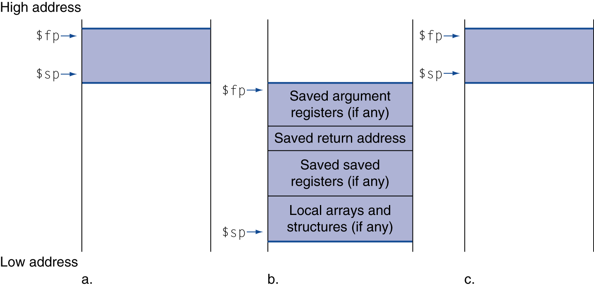
Local Data on the Stack
Local data allocated by callee
e.g., C automatic variables
Procedure frame (activation record)
Used by some compilers to manage stack storage

Slide 23
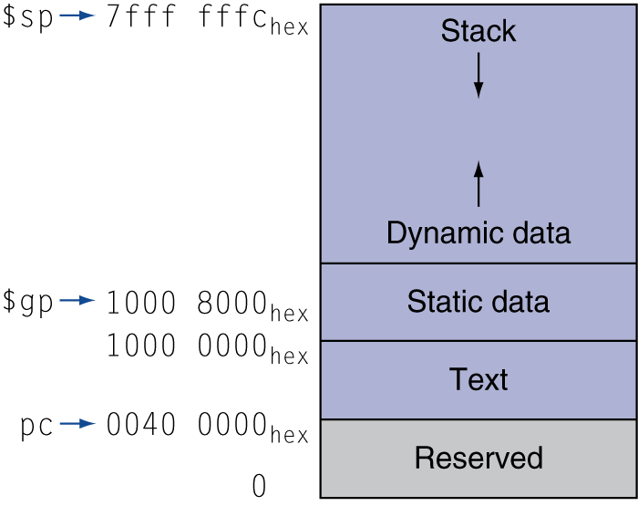
Memory Layout
Text: program code
Static data: global variables
e.g., static variables in C, constant arrays and strings
$gp initialized to address allowing ±offsets into this segment
Dynamic data: heap
E.g., malloc in C, new in Java and C++
Stack: automatic storage

Slide 24
Next Time
More MIPS instructions….

